Slide 1

THE ROLE OF NATURAL GAS IN A NET ZERO WORLD

Slide 2

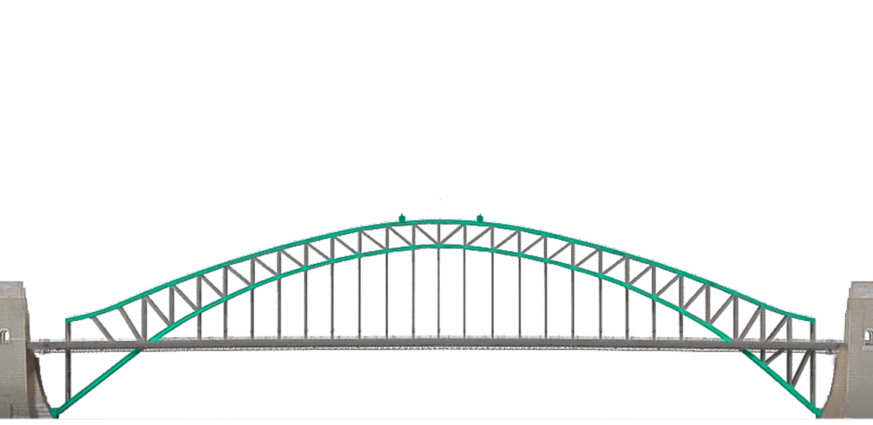

Slide 3







Slide 4
Natural gas plants have much lower CO₂ emissions than coal plants

Slide 5
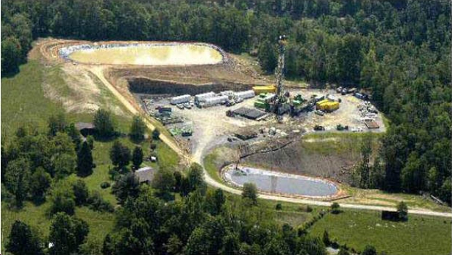
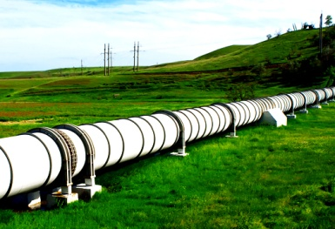
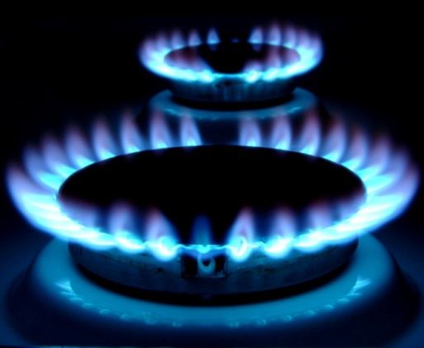
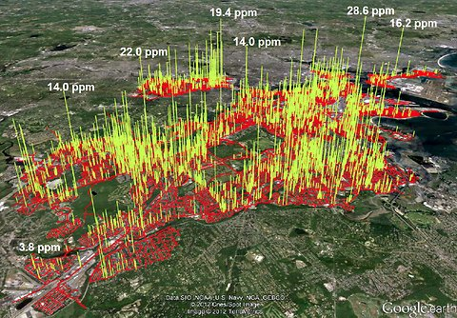
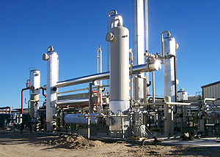
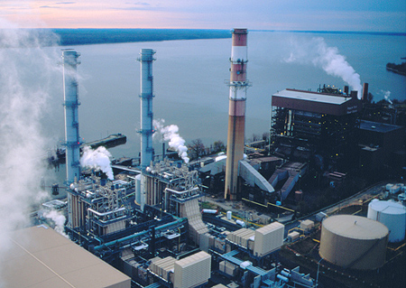
Methane leakage from natural gas

Slide 6
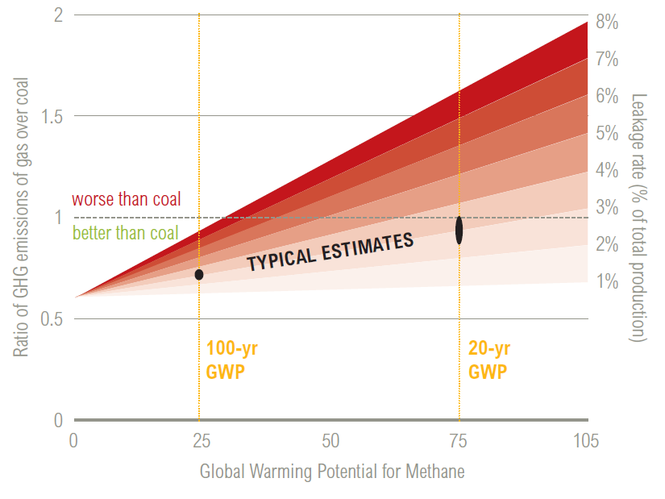
Methane leakage must be below 2-3%
to have lower emissions than coal

Slide 7

Equity & environmental justice issues with natural gas

Slide 8
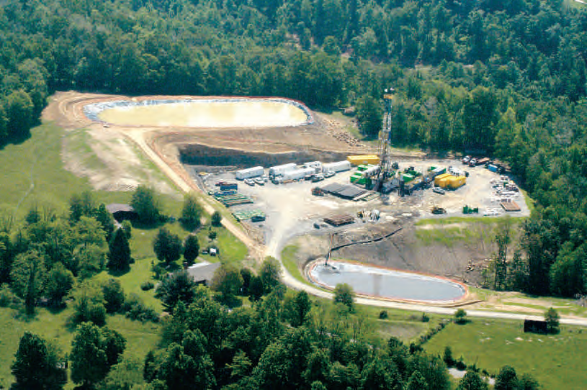
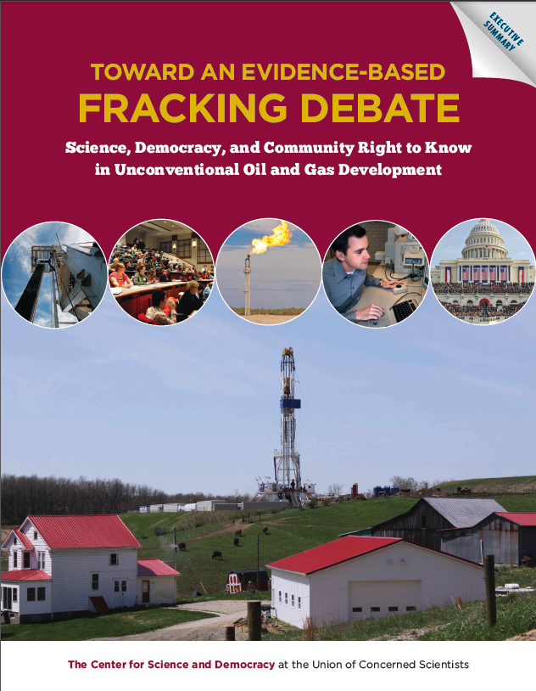
Environmental, Health and Safety Impacts
  Air and water pollution
  Water use
  Fugitive methane emissions
  Industrialization of rural landscapes and communities
  Ancillary impacts from sand mining, injection wells, etc.

Slide 9








Nuclear capacity retirements accelerate with lower natural gas prices—

Slide 10
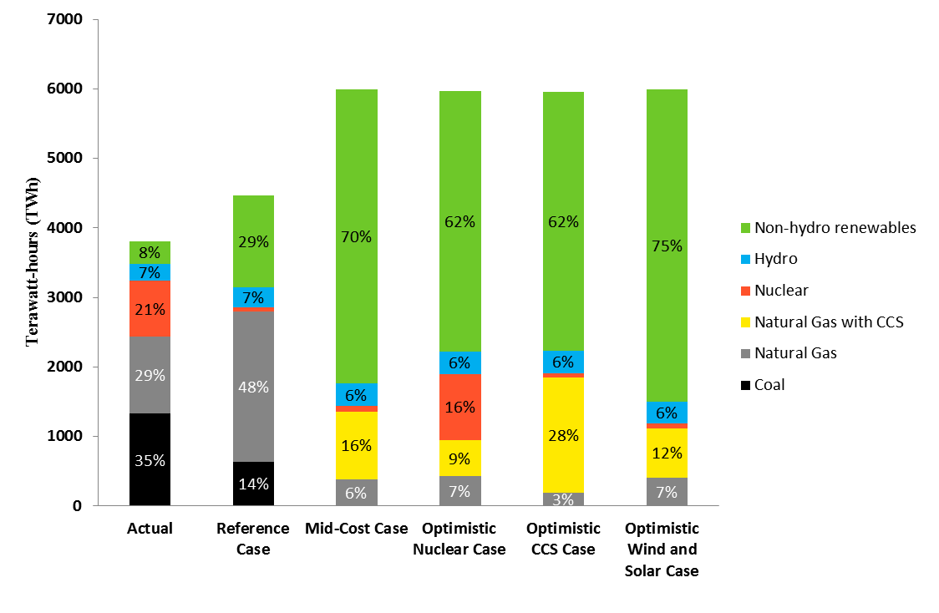
U.S. Electricity Mix in 2050 with Deep Decarbonization
2015
2050

Slide 11
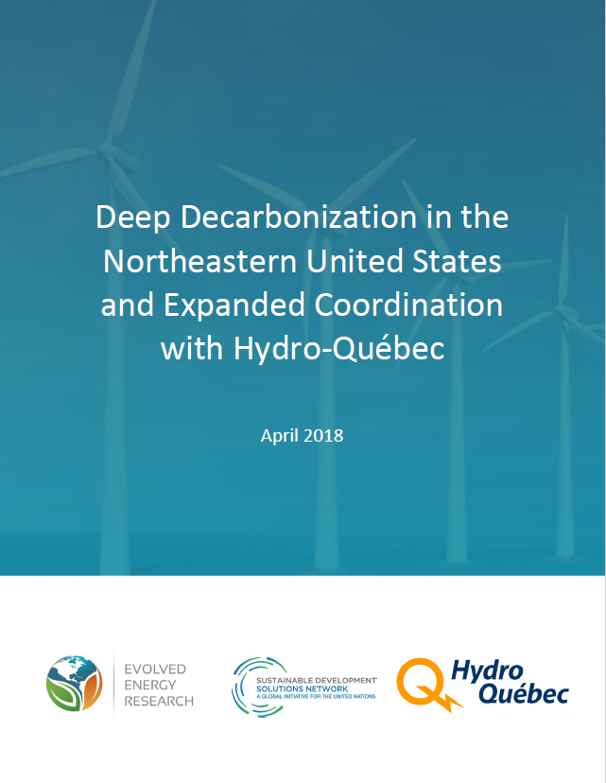

Slide 12


Slide 14
Wind
Solar
Wind & Solar
UCS, for ACORE RE Forum 03-2020

Slide 15
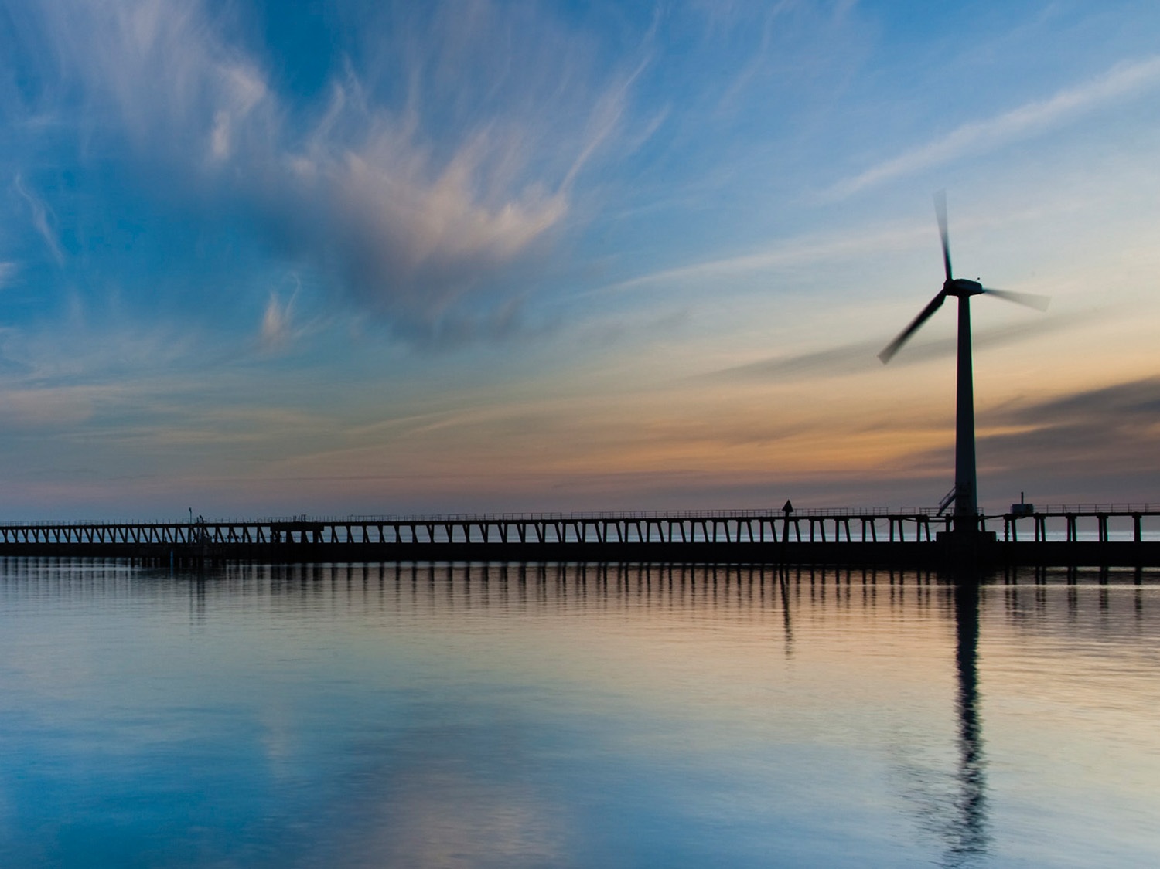


Thank You
Text SCIENCE to 662266 to receive UCS text messages directly to your phone.

